Slide 1
Doel
Verkrijg een zo goed mogelijke vouwing
- Zoveel mogelijk H-bruggen

Slide 2
Algoritmes
Brute Force (+ Pruning) [Depth First]
Monte Carlo
Simulated Annealing

Slide 3
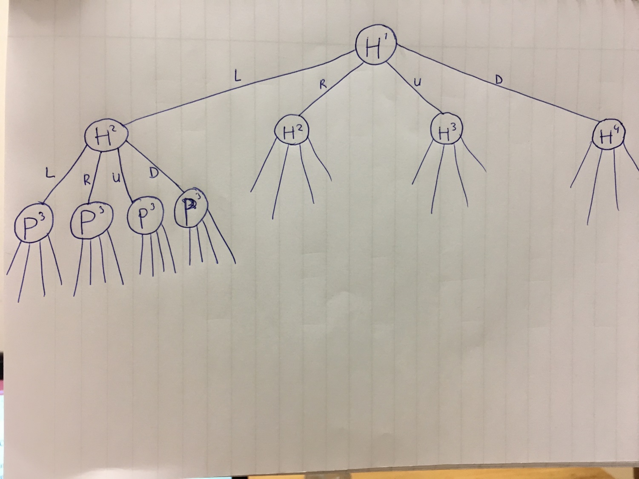
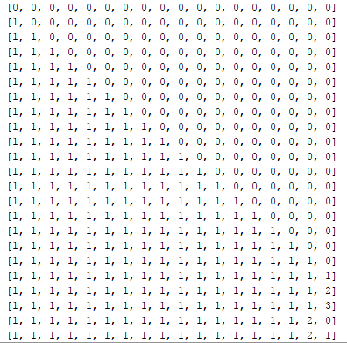
Brute Force + Depth First Pruning
Per aminozuur 4 mogelijke moves: L, R, U, D
l-l-l-l-l-l-l
l-l-l-l-l-l-r
l-l-l-l-l-l-u
l-l-l-l-l-l-d
l-l-l-l-l-r-l
...
l-l-l-l-l-r-d
l-l-l-l-l-u-l
...
l-l-l-l-l-d-d
l-l-l-l-r-l-l
...
l-l-l-l-r-d-d
Etc.

Slide 4
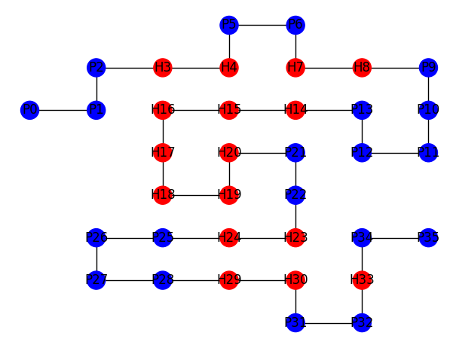
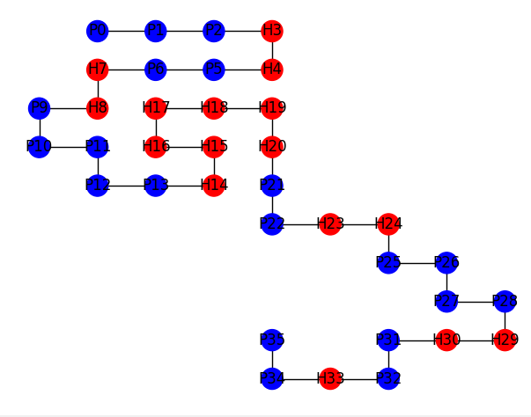
Monte Carlo
Random self avoiding paths
Voordelen: Iteraties instelbaar, pruning niet nodig, als je snel een basis streng nodig hebt. Je haalt de exponentie eruit
Nadelen: Borduurt niet voort op goede uitkomsten, uitkomst gebaasd op kans

Slide 5
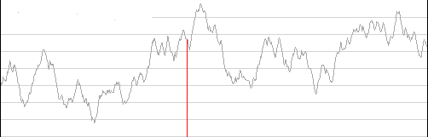
Monte Carlo + Hill Climbing
Monte Carlo als basis streng
Kans op local maximum

Slide 6
State Space
n: amount of amino acids
State Space: 4^(n-1)
Upper Bound: 3^(n-2) / 2
Lower Bound:
Optimal Score:
2 * min{|EVEN(H)|,|ODD(H)|} + 2
Notes:
3^(n-2): -2 ipv -1 om de rotatiesymmetrie eruti te halen, de eerste is naar rechts gezet, 3 ipv 4 vanwege terugvouwen, /2 vanwege spiegelbeeldsymmetrie

Slide 7
State Space
Eiwit (n) | State Space | Upper Bound | Optimal Score
HHPHHHPH (8) | 16.384 | 365 | -6
HHPHHHPHPHHHPH (14) | 6.7 • 10⁷ | 265.721 | -8
HPHPPHHPHPPHPHHPPHPH (20) | 2.7 • 10¹² | 1.9 • 10⁸ | -12
PPPHHPPHHPPPPPHHHHHHHPPHHPPPPHHPPHPP (36) | 1.2 • 10²¹ | 8.3 • 10¹⁵ | -16
HHPHPHPHPHHHHPHPPPHPPPHPPPPHPPPHPPPHPHHHHPHPHPHPHH (50) | 32 •10³⁰ | 4.0 • 10²² | -26
Leeftijd Heelal: 4,4 • 10¹⁷ seconde

Slide 8
Resultaten
Eiwit (n) | State Space | Upper Bound | Optimal Score
HHPHHHPH (8) | 16.384 | 365 | -6
Brute Force
Iteraties: 4096
Highscore: -3
Aantal: 12
[NetworkX visualisaties]

Slide 9
Resultaten
Eiwit (n) | State Space | Upper Bound | Optimal Score
HHPHHHPHPHHHPH (14) | 6.7 • 10⁷ | 265.721 | -8
Brute + Pruning
Iteraties: 386173
Highscore: -6
Aantal: 56
[NetworkX visualisaties]

Slide 10
Resulaten
Eiwit (n) | State Space | Upper Bound | Optimal Score
HPHPPHHPHPPHPHHPPHPH (20) | 2.7 • 10¹² | 1.9 • 10⁸ | -12
Brute + Pruning
Iteraties:
Highscore:
Aantal:
[NetworkX visualisaties]

Slide 11
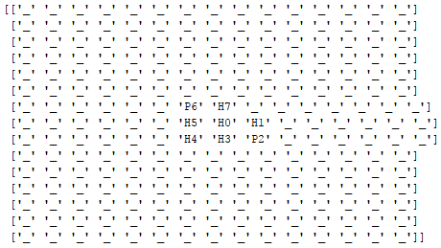
Grid vs Coordinaat methode
36 Aminozuren
8 Aminozuren
[[36, 36], [37, 36], [37, 35], [37, 34], [37, 33], [38, 33], [39, 33], [39, 34], [38, 34], [38, 35], [39, 35], [40, 35], [40, 36], [41, 36], [42, 36], [42, 35], [43, 35], [43, 34], [43, 33], [42, 33], [42, 34], [41, 34], [40, 34], [40, 33], [40, 32], [39, 32], [39, 31], [40, 31], [41, 31], [41, 32], [42, 32], [42, 31], [43, 31], [43, 30], [43, 29], [44, 29]]
50 Aminozuren
[[50, 50], [51, 50], [51, 49], [52, 49], [52, 48], [51, 48], [51, 47], [50, 47], [49, 47], [49, 48], [50, 48], [50, 49], [49, 49], [49, 50], [48, 50], [47, 50], [47, 49], [46, 49], [45, 49], [44, 49], [43, 49], [43, 50], [43, 51], [43, 52], [42, 52], [42, 53], [43, 53], [43, 54], [43, 55], [43, 56], [43, 57], [43, 58], [44, 58], [44, 59], [44, 60], [45, 60], [45, 59], [45, 58], [45, 57], [44, 57], [44, 56], [45, 56], [46, 56], [47, 56], [47, 57], [46, 57], [46, 58], [46, 59], [47, 59], [47, 58]]

Slide 12
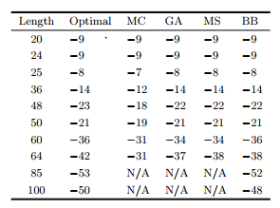
Resultaten Monte Carlo
8 – 100 iteraties – 0,01 seconden
14 – 1000 iteraties – 0,3 seconden
20 – 100000 iteraties – 40 seconden(Niet altijd, vaak 7)
36 – 800000 iteraties – 16 minuten
50 – 1000000 iteraties – 20 minuten
Meestal 17, soms 19

Slide 13
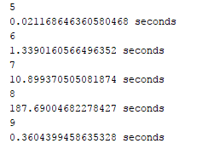
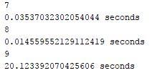
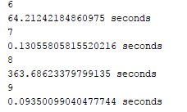
Monte Carlo + Hill Climbing
Heel veel locale maxima
Op een 36 streng van score 4-6, max is (14 -12)

Slide 14
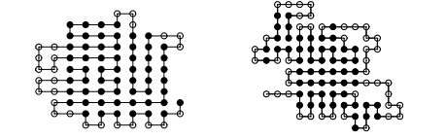
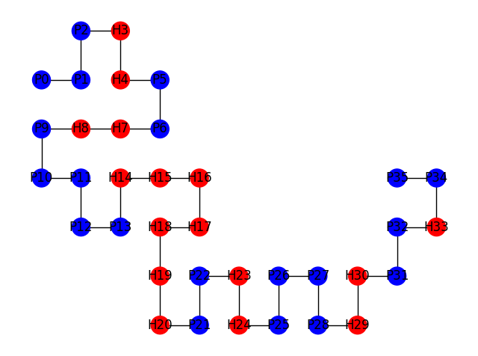

Hoe zien Ideale vouwingen eruit?

Slide 15
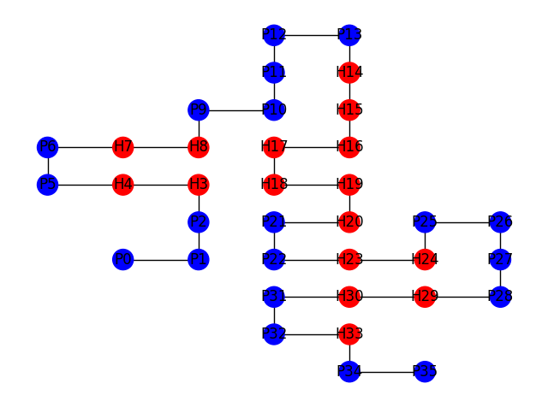
Simulated Annealing

